Slide 1
Citi TV Ad Research Project
Xichen Luo

Slide 2

Project Goals
The project is to help our client, Citi, to understand their TV Ad performance based on KPI analysis.
Based on the performance, the project gives suggestions to help launch new and optimize ongoing TV Retargeting digital media campaigns.

Slide 3




Ad stats
Date Range: Jan 1st, 2018 - Feb 5th, 2020
Number of Airings: 25,111
Number of Views: 2,263,065,480
Total Spend: $113M

Slide 4
Content
Network
DayParts
Creative
Creative-Length
DayOfWeek
Product
Recommendations
KPI Analysis

Slide 5

KPI Analysis

Slide 6
KPI ANALYSIS
Kpi Analysis is to measure the performance of Citi TV AD. Two KPIs are used to analyze the performance of Citi TV Ads under 6 dimensions:
Network
DayParts
Creative
Creative-Length
DayOfWeek
Product
Each KPI give one perspective of performance:
KPI 1: Views per Airing (= Total Views/Total Airings)
Views per Airing is to measure the efficiency of airings
KPI 2: Cost per View (= Total Spend/Total Views)
Cost per View is to measure the cost to earn a view, which is also the cost efficiency

Slide 7
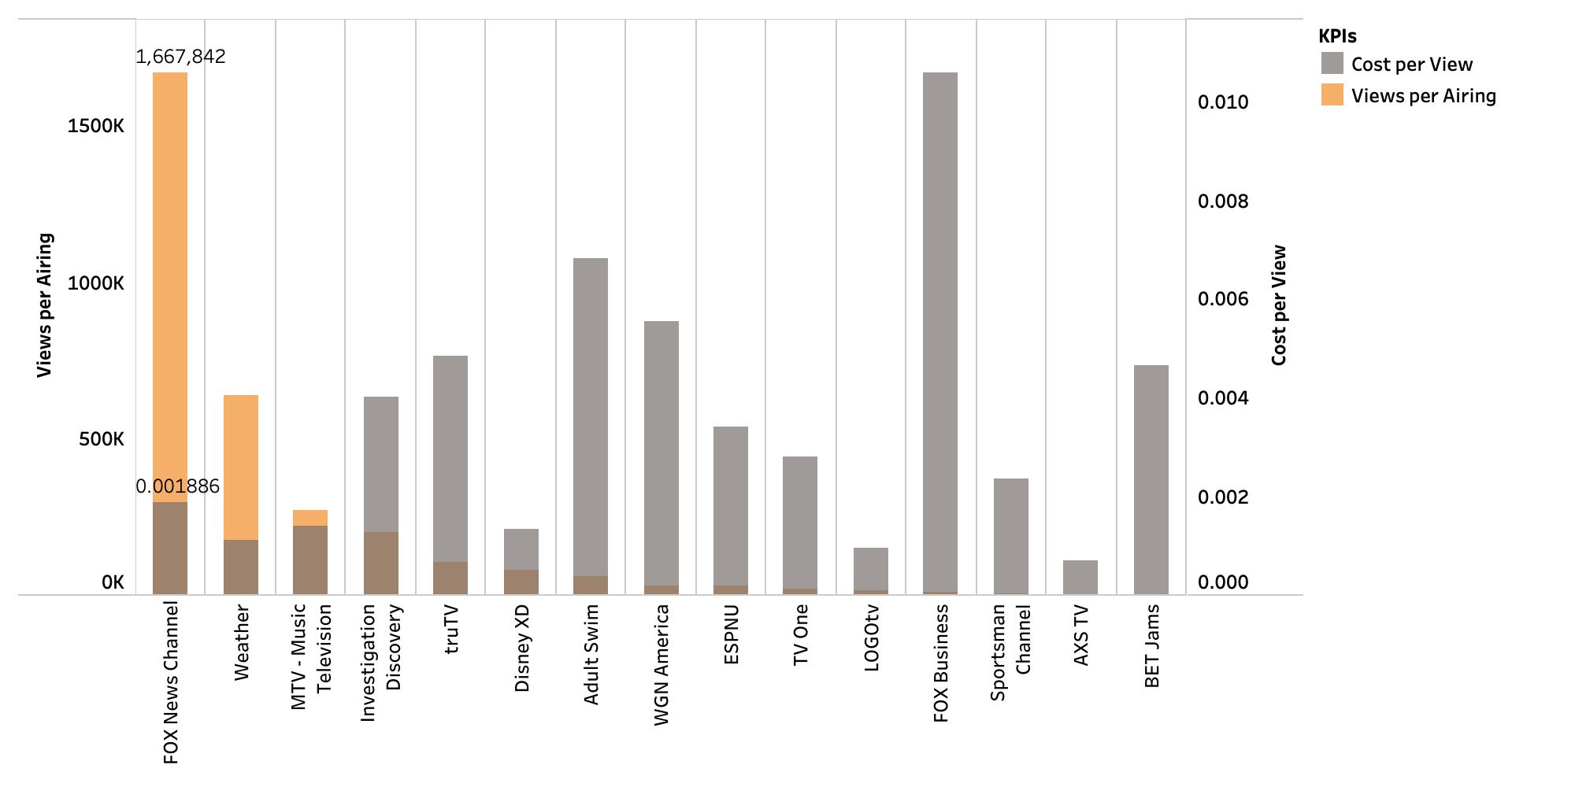
network – ranked by views per airing
Fox News Channel earns the highest views per airing, giving the highest efficiency of airing, and it costs around 0.2 cent to get a view.

Slide 8
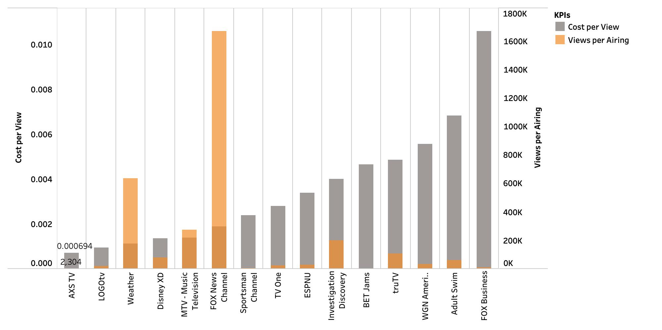
network – ranked by cost per view
AXS TV has the lowest cost per view, giving the highest cost efficiency, and its views per airing is 2,304.

Slide 9
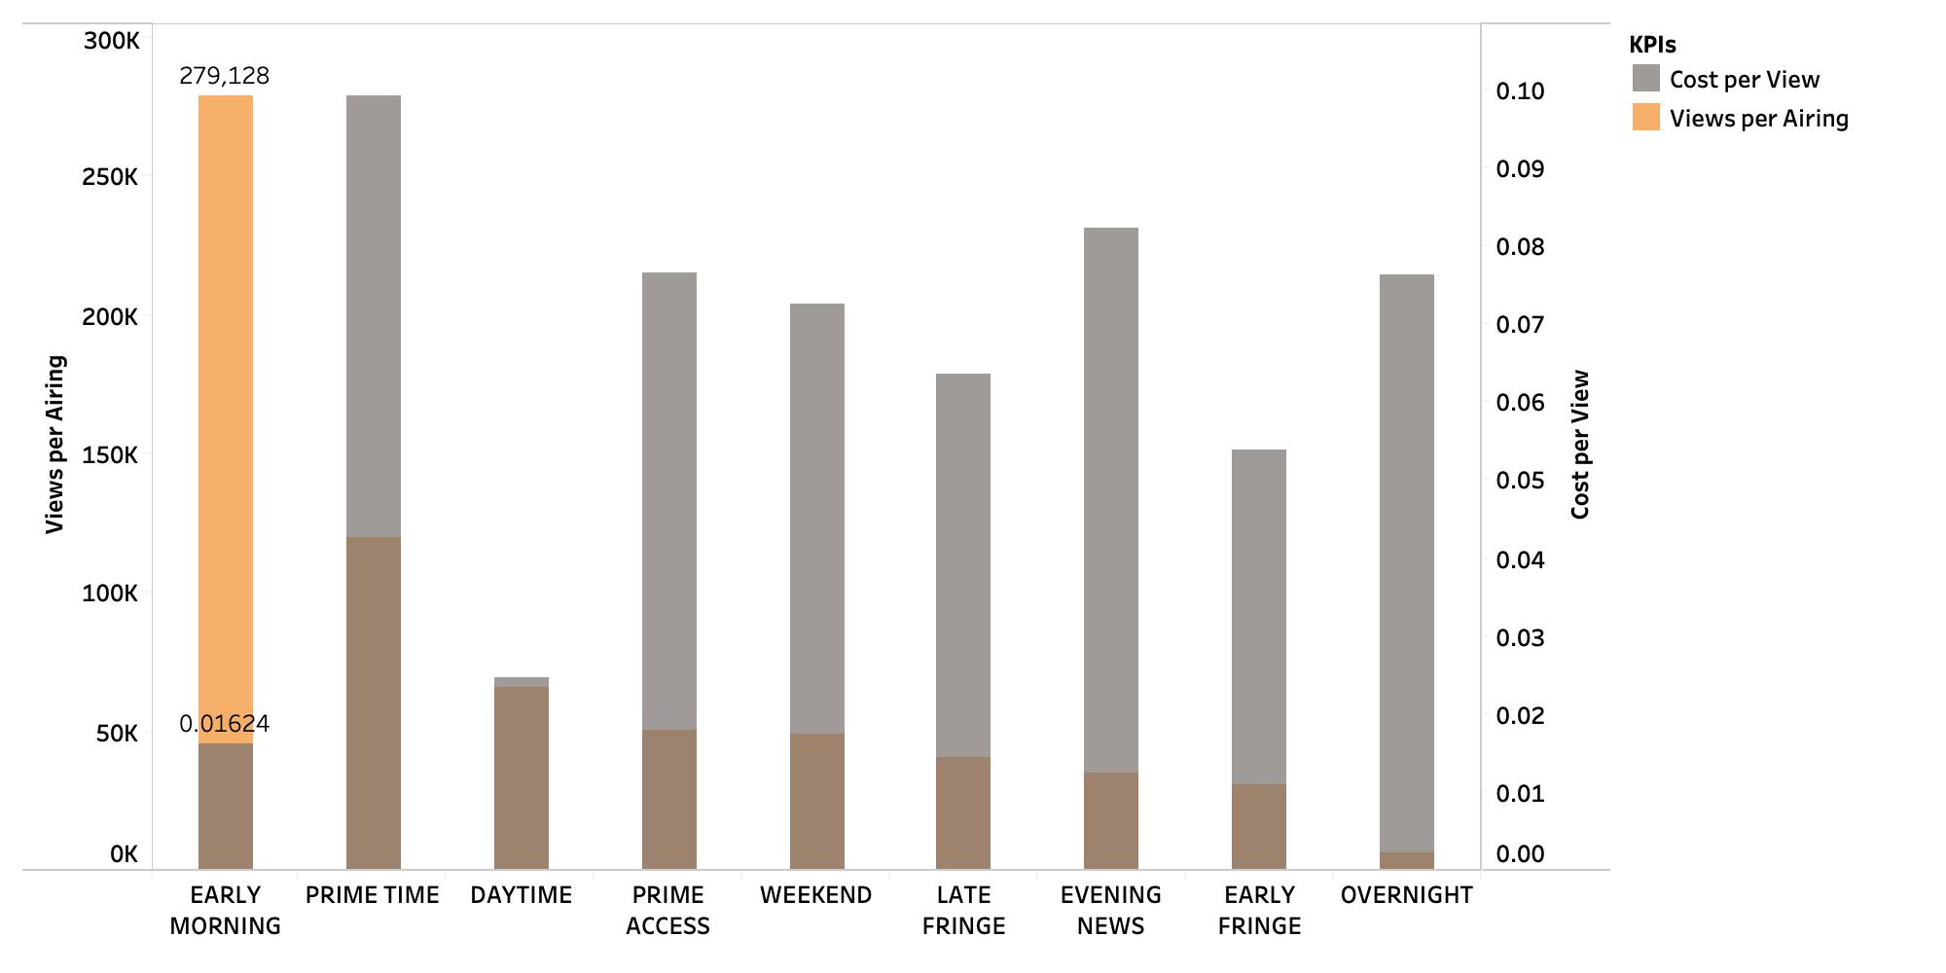
Dayparts – ranked by views per airing
Early Morning earns the highest views per airing, giving the highest efficiency of airing, and it costs around 1.6 cents to get a view.

Slide 10
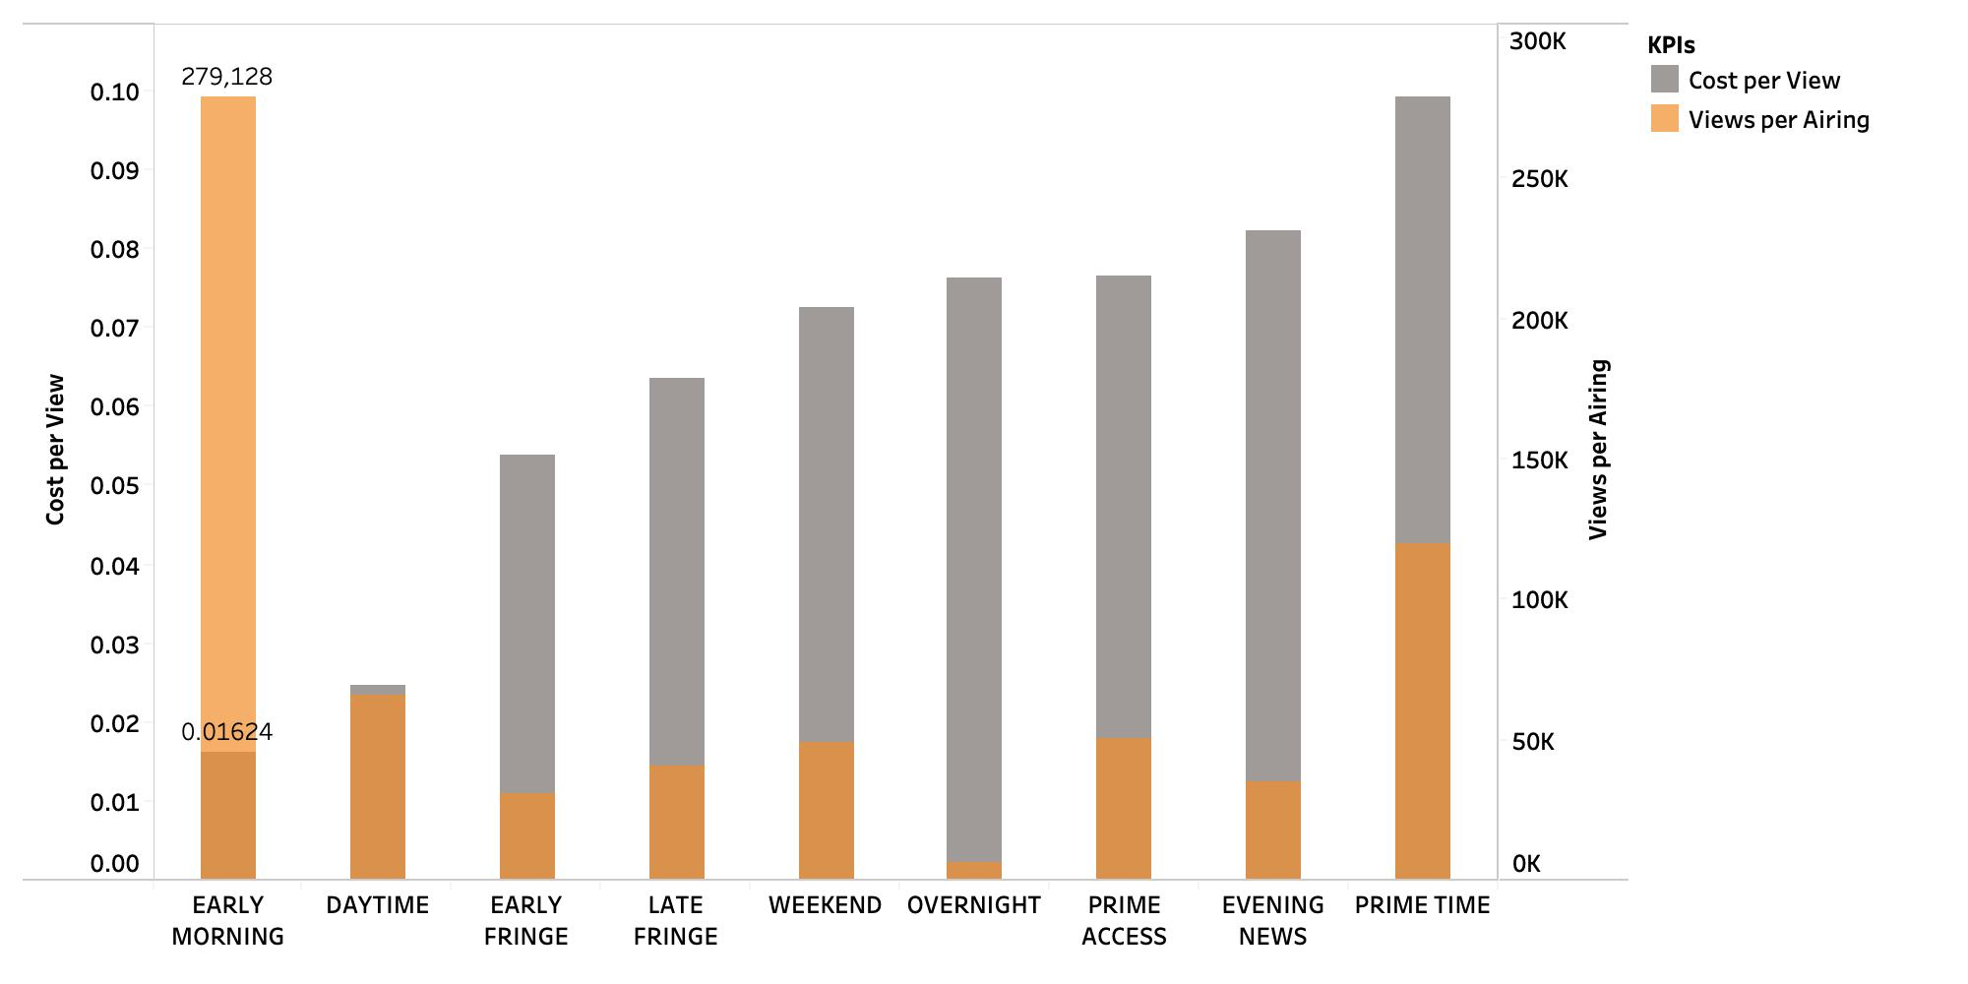
Dayparts – ranked by cost per view
Early Moring has the lowest cost per view, giving the highest cost efficiency, and its views per airing is 279,128.

Slide 11
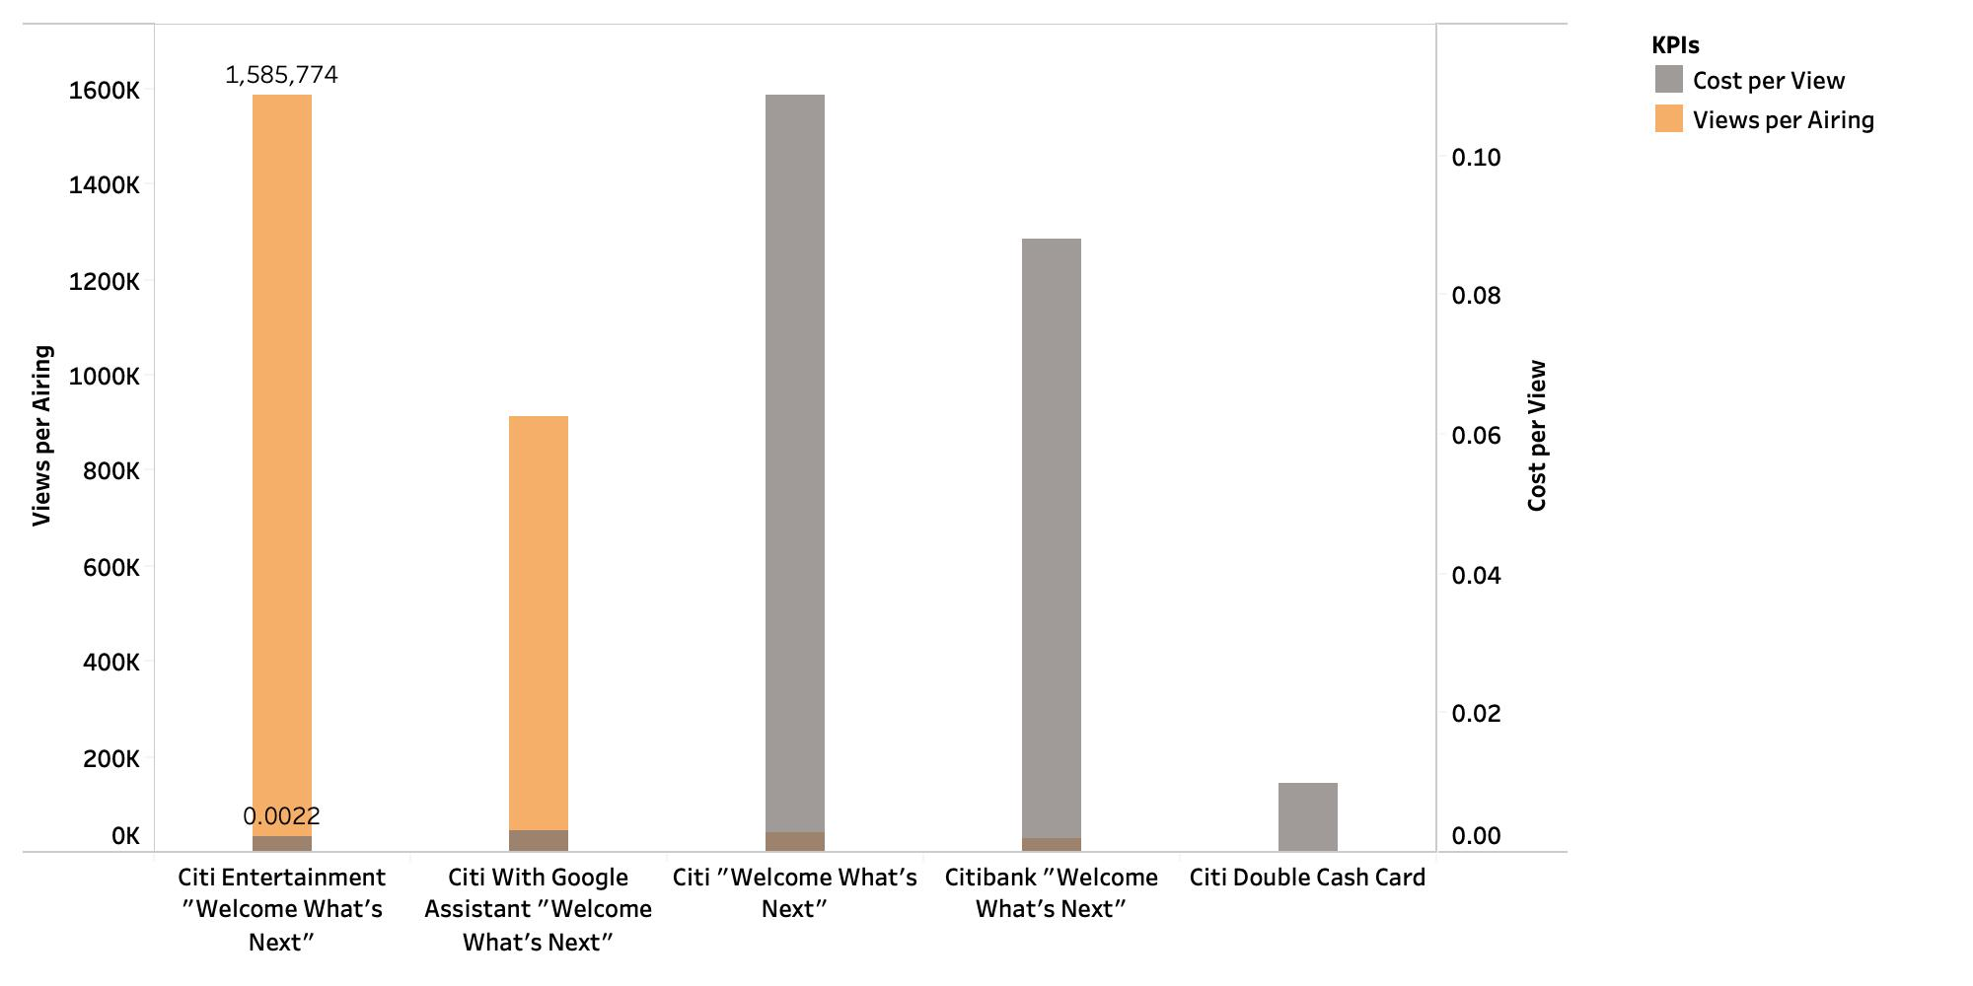
Creative – ranked by views per airing
﻿Creative Citi Entertainment "Welcome What's Next" earns the highest views per airing, giving the highest efficiency of airing, and it costs around 0.2 cent to get a view.

Slide 12
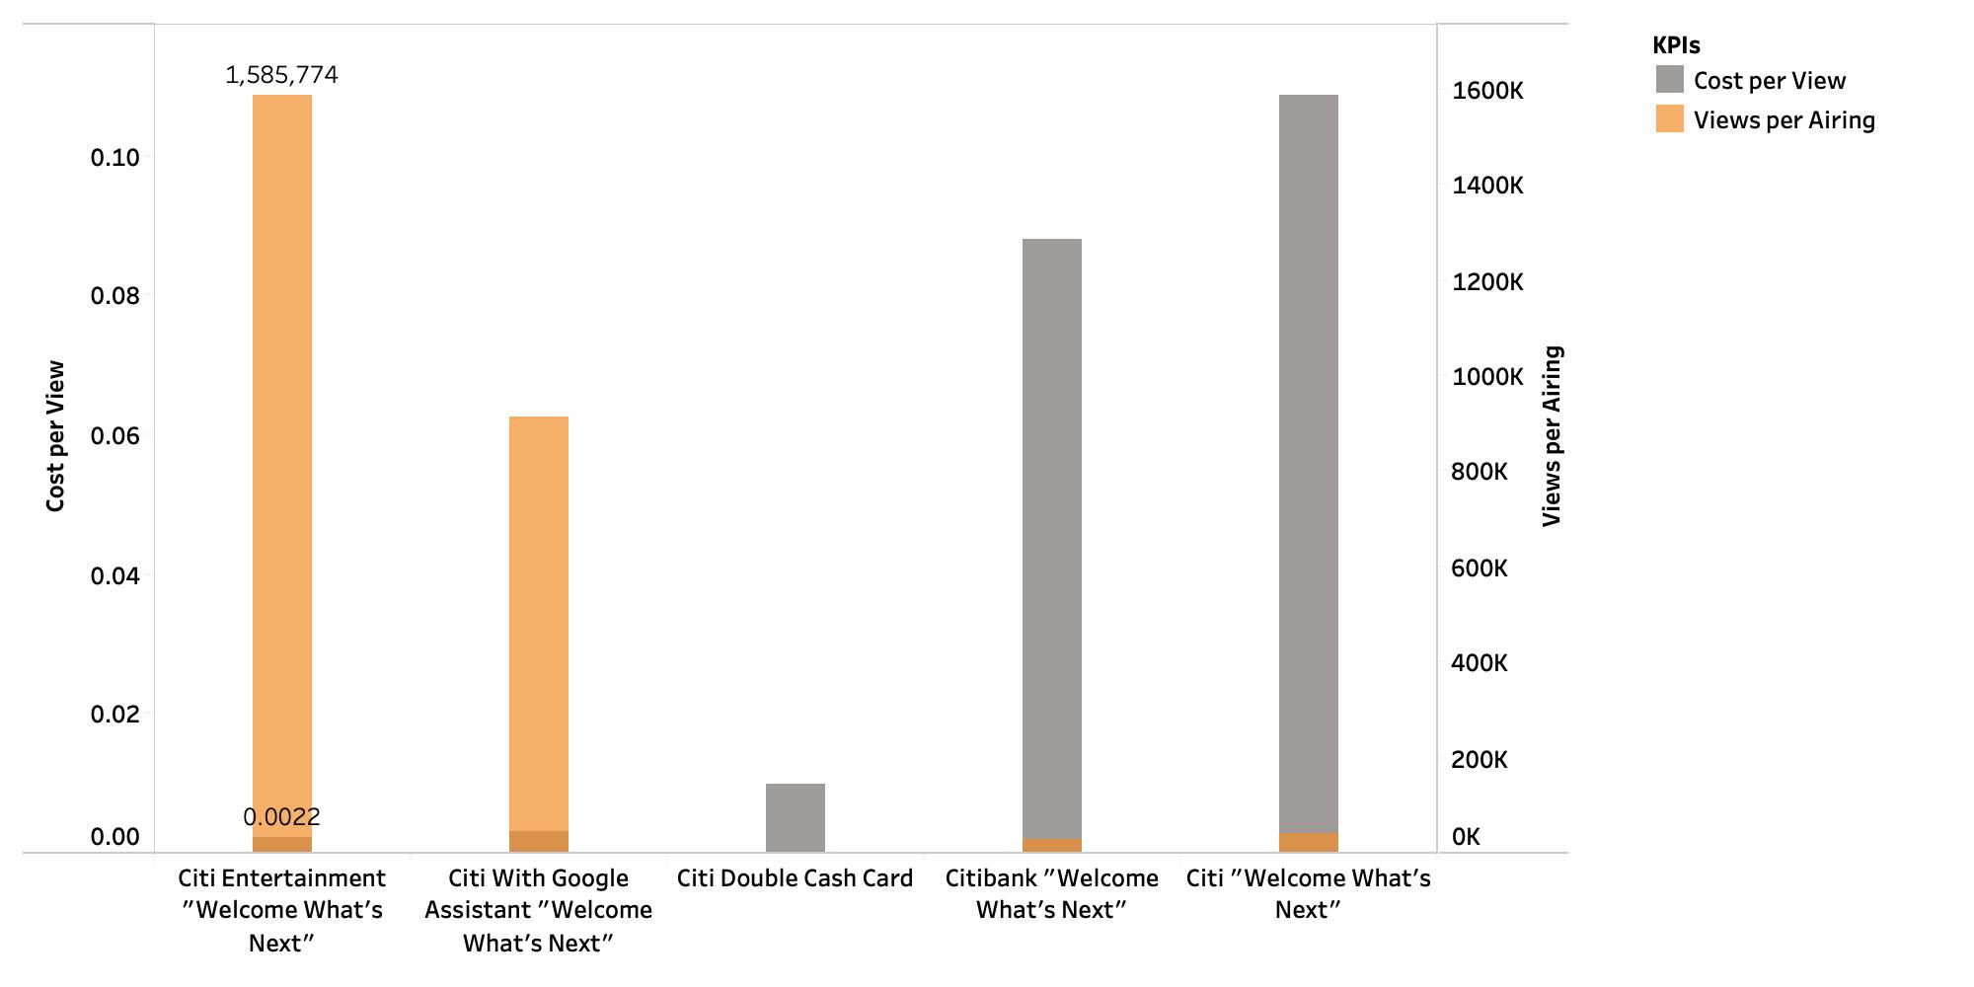
Creative – ranked by cost per view
﻿Creative Citi Entertainment "Welcome What's Next" has the lowest cost per view, giving the highest cost efficiency, and its views per airing is 1,585,774.

Slide 13
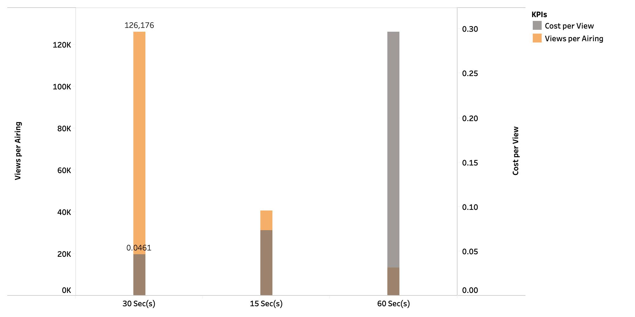
Creative - length – ranked by views per airing
﻿30 seconds earn the highest views per airing, giving the highest efficiency of airing, and it costs around 4.6 cents to get a view.

Slide 14
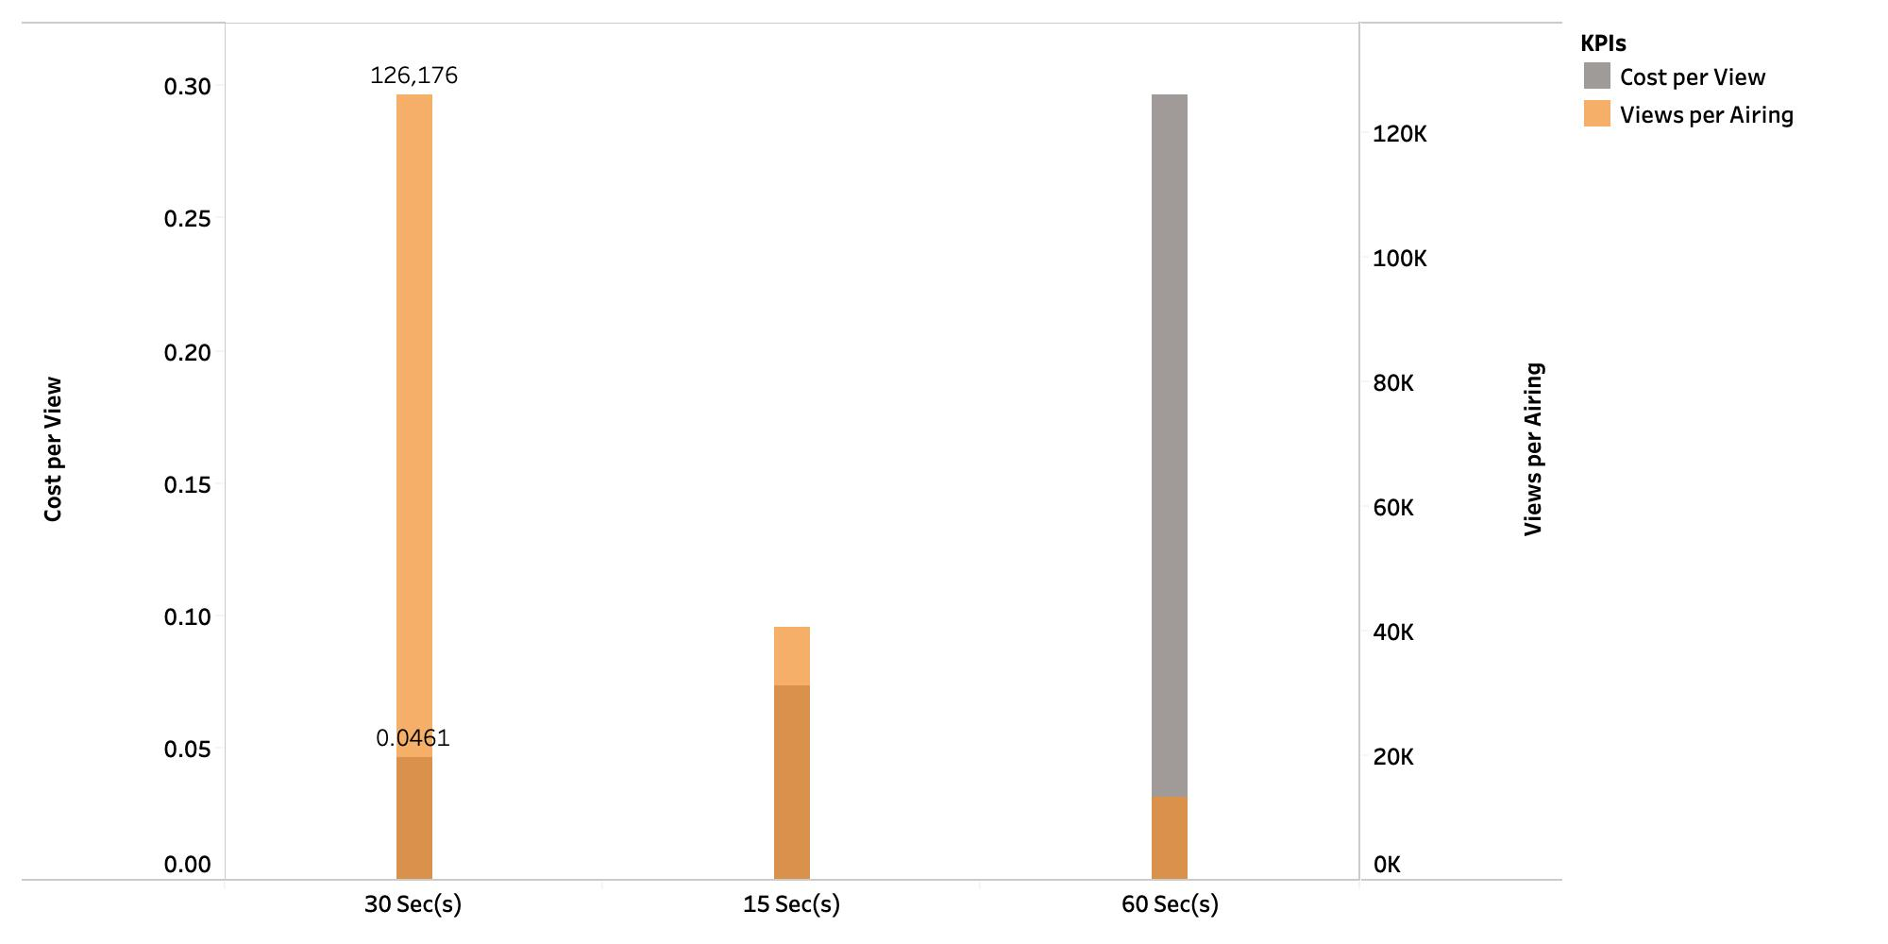
Creative - length – ranked by cost per view
﻿30 seconds have the lowest cost per view, giving the highest cost efficiency, and its views per airing is 126,176.

Slide 15
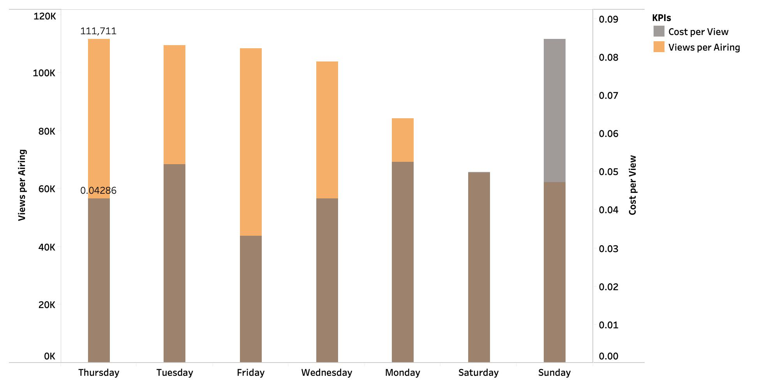
Dayofweek – ranked by views per airing
﻿Thursday earns the highest views per airing, giving the highest efficiency of airing, and it costs around 4.3 cents to get a view.

Slide 16
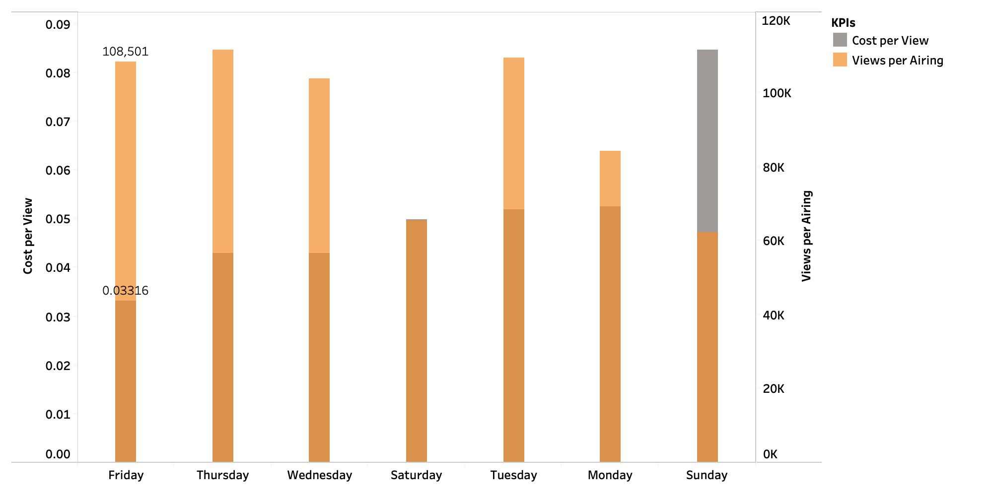
Dayofweek – ranked by cost per view
﻿Friday has the lowest cost per view, giving the highest cost efficiency, and its views per airing is 108,501.

Slide 17
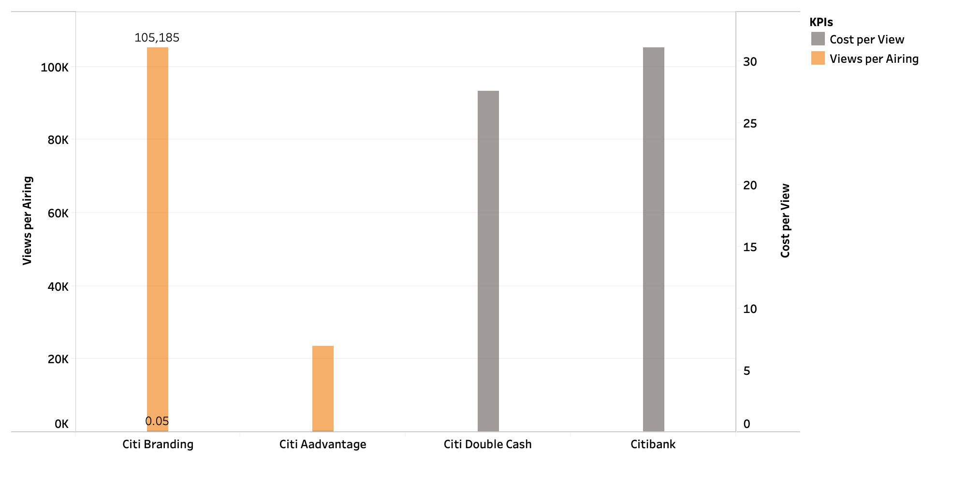
Product – ranked by views per airing
﻿Citi Branding earns the highest views per airing, giving the highest efficiency of airing, and it costs around 5 cents to get a view.

Slide 18
Product – ranked by views per airing
﻿Citi Branding has the lowest cost per view, giving the highest cost efficiency, and its views per airing is 105,185.

Slide 19
KPI ANALYSIS Optimization Matrix
The Optimization Matrix is to conclude the best combination of six dimensions based on each of KPIs
Views per Airing: select the value that reaches the highest Views per Airing (highest efficiency of airing)
Cost per View: select the value that reaches the lowest Cost per View (lowest cost to earn a view)
Dimensions | Views per Airing | Cost per View
By Network | Fox News Channel | AXS TV
By DayParts | Early Morning | Early Morning
By Creative | Citi Entertainment "Welcome What's Next" | Citi Entertainment "Welcome What's Next"
By Creative-Length | 30 Sec(s) | 30 Sec(s)
By DayOfWeek | Thursday | Friday
By Product | Citi Branding | Citi Branding

Slide 20
Suggestions

Slide 21
Suggestions
According to the Optimization Matrix, Citi could choose the combination depending on which business cycle and marketing strategy it is in:
If Citi (or a Citi product) is at a growth or early stage, and its marketing strategy is to gain awareness and popularity: Citi should put more weight on Views per Airing, which is the efficiency of airing.
If Citi (or a Citi product) is at a mature stage, and its marketing strategy is to maintain sales and keep profits, Citi should pay attention to Cost per View, to save costs.
Besides, to better help Citi update or retarget its marketing campaigns, more factors that could change the results given by KPIs should be considered:
Seasonality
Holidays: Christmas, Thanksgiving
Demographic Characteristics

